Slide 1
Selecting the right database for your semantic storage needs
Taxonomy Boot Camp London 2017
Jim Sweeney, Senior Product Manager
Taxonomy and Ontology Solutions

Slide 2
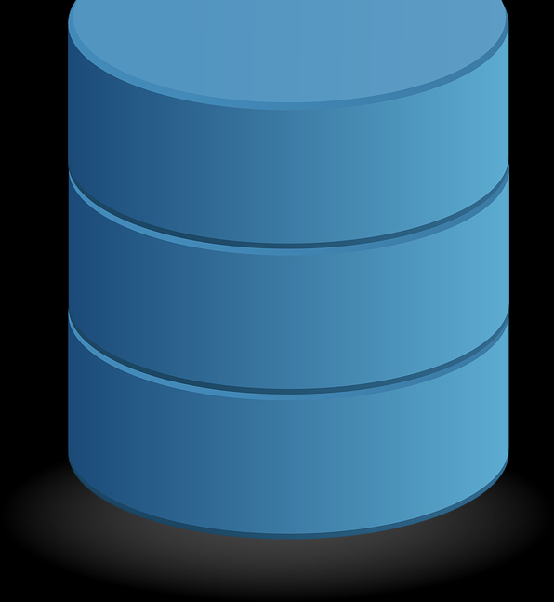
Database Types
There are a number of different database types available. We will look at three key designs as they relate to storing semantic information.
Relational Database Management Systems (RDBMS)
Property Graph Databases
RDF Databases (a specialized form of Graph Database)

Slide 3
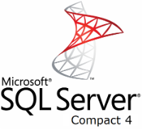
A Brief History
The relational database did not appear until the late 1970’s replacing Navigational database designs of the previous decade.
The first commercial versions started to appear in the early 1980’s with IBM’s DB2 and Oracle’s products leading the way.
Microsoft released their SQL Server platform in 1989.
These three providers continue to be among the leaders as far as market share across all database types.

Slide 4
A Brief History (Continued)
Graph database systems begin to appear in the late 1990’s, coinciding with the adoption of RDF as a W3C recommendation.
Leading Property Graph and RDF database providers such as Neo4J, GraphDB, and Jena (to name just a few) continue to grow in market share but still represent just a fraction of the total market share.
Rank |  |  | DBMS | Database Model | Score
Oct | Oct |  |  | Oct | Sep | Oct
2017 | 2016 |  |  | 2017 | 2017 | 2016
1 | 1 | Oracle | Relational DBMS | 1348.8 | -10.29 | -68.3
2 | 2 | MySQL | Relational DBMS | 1298.83 | -13.78 | -63.82
3 | 3 | Microsoft SQL Server | Relational DBMS | 1210.32 | -2.23 | -3.86
4 | 5 | PostgreSQL | Relational DBMS | 373.27 | 0.91 | 54.58
5 | 4 | MongoDB | Document store | 329.4 | -3.33 | 10.6
6 | 6 | DB2 | Relational DBMS | 194.59 | -3.75 | 14.03
7 | 8 | Microsoft Access | Relational DBMS | 129.45 | 0.64 | 4.78
8 | 7 | Cassandra | Wide column store | 124.79 | -1.41 | -10.27
9 | 9 | Redis | Key-value store | 122.05 | 1.65 | 12.51
10 | 11 | Elasticsearch | Search engine | 120.23 | 0.23 | 21.12
21 | 21 | Neo4j | Graph DBMS | 37.95 | -0.48 | 1.5
89 | 86 | Jena | RDF store | 2.31 | 0.04 | 0.5

Slide 5
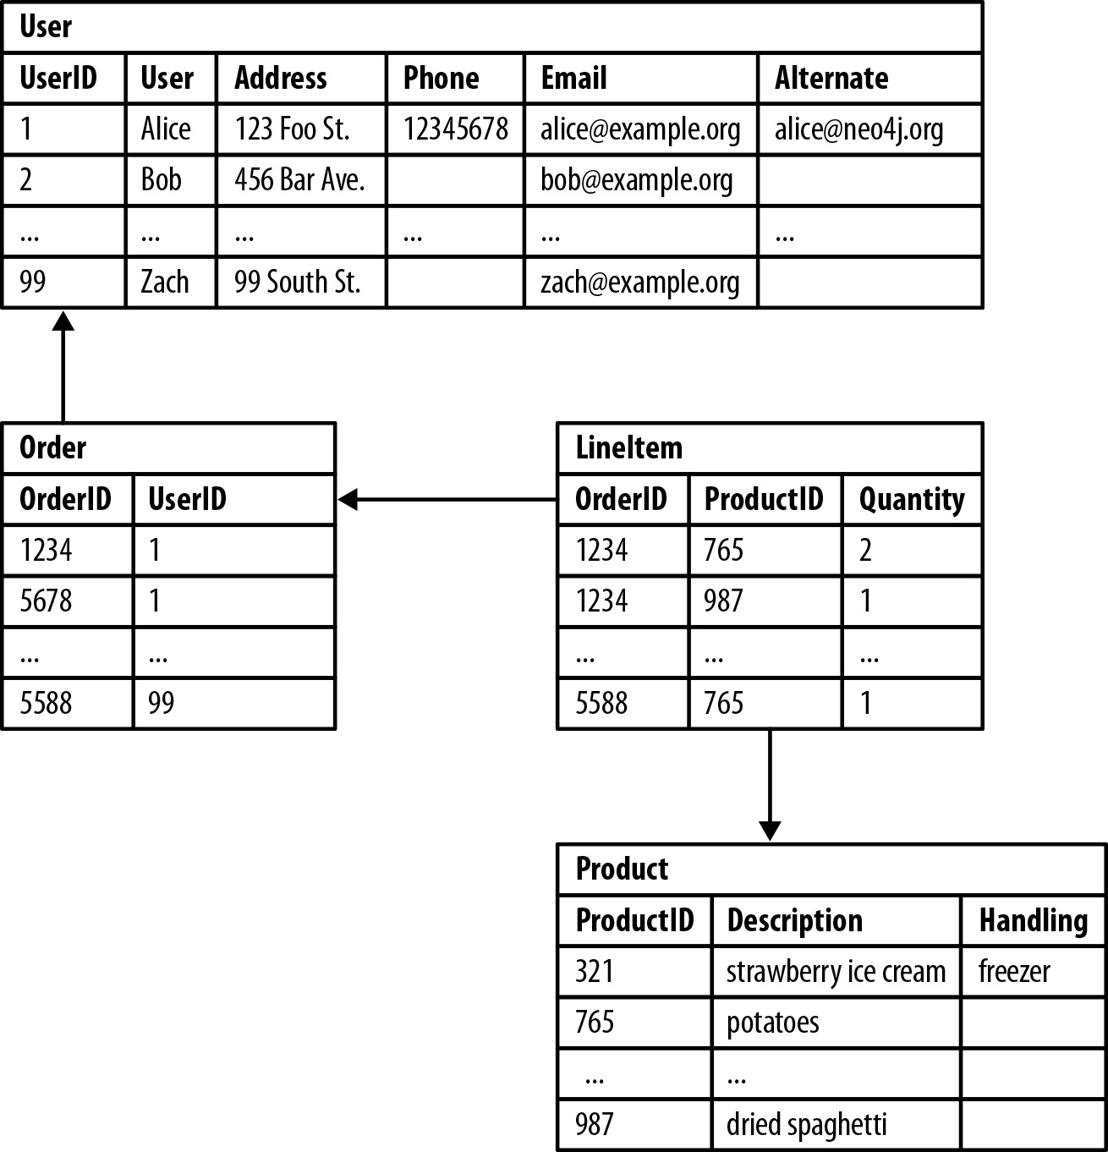
Relational Databases Management Systems (RDBMS)
RDBMS are designed using multiple tables to store data.
Each table is made up of headers, rows, and columns, much like a spreadsheet.
Each row contains different elements, including a primary key and zero to many foreign keys.
These keys are used to link information in one table to another table, which will contain distinct but related information.
Image from neo4j.com

Slide 6
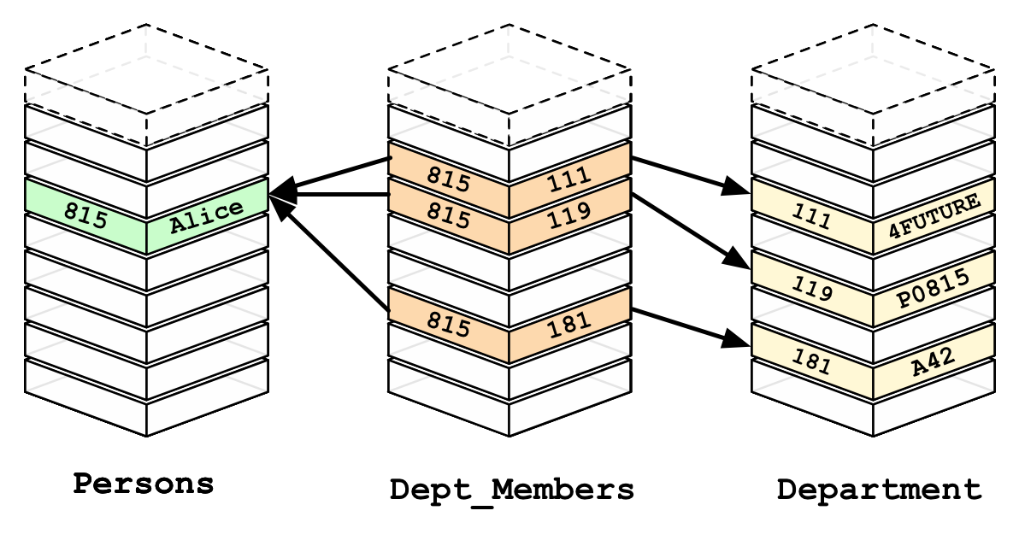
RDBMS Design
The use of a key in each table means that there is no “relationship” as we would find in natural language or a graph structure.
Table values themselves are what link the data together by creating a join between data elements using keys.
Image from neo4j.com

Slide 7
Pros and Cons of RDBMS
Pros:
RDBMS are tried and tested over many decades, and generally have more features available than newer platforms.
RDBMS are very efficient at storing indexable information that is described well in “tabular” structures, such as accounting or inventory data.
Data is often indexed at the time of entry, making keyword searches and those with limited table joins relatively fast.

Slide 8
Pros and Cons of RDBMS
Cons:
RDBMS require a foreknowledge of all the data, and consequently data tables, that you will be storing. (Graph structures provide more ad hoc design flexibility.)
RDBMS don’t perform as well in pattern matching searches as the number of relationships to be traversed increases.
SQL language, while widely known, is slightly more complex than those used with Property Graph or RDF systems.

Slide 9
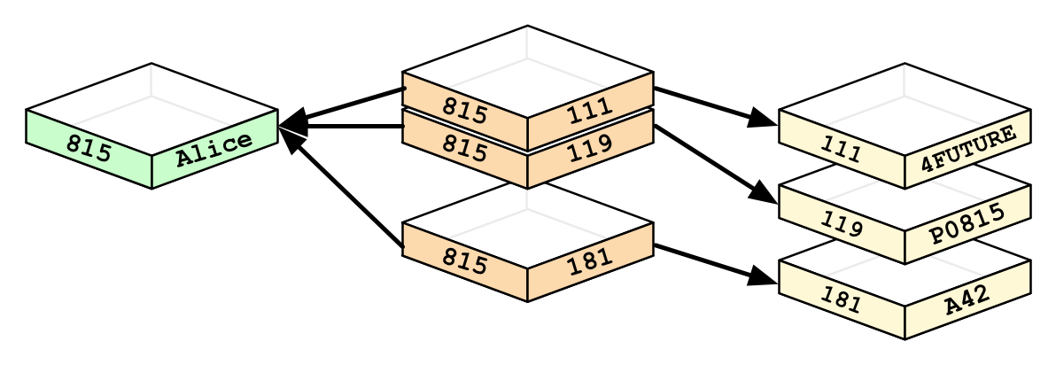
RDBMS Deconstructed
As we have seen, Relational Databases use tables and key values to link information together.
Let’s focus on just the highlighted components to compare this design with that of a Graph database.
Image from neo4j.com

Slide 10
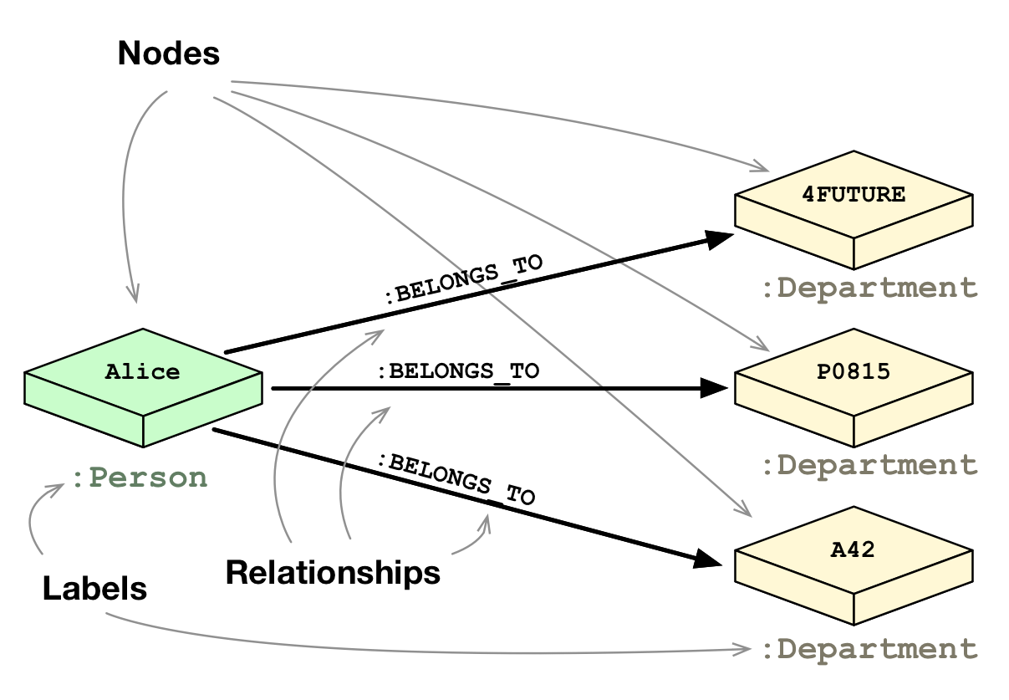
The Graph Model
With a graph database, such as Neo4j, each node is a standalone item that describes a fully-formed member of the database.
To link the nodes together, one uses relationships. These are referred to as edges.
The nodes and edges form uniform structures which are repeated to relate all of the data elements, completely describing all necessary aspects of the information in the database.
Image from neo4j.com

Slide 11
The Graph Model (continued)
If we look at our example with Alice, we see that she belongs to several departments. The nature of the link from the person, Alice, to the Departments is described by the relationship itself, in this case “:BELONGS_TO”.
The node-edge-node combination that is formed has Alice belonging to the department “4FUTURE”.
No longer are we linking items via table joins. We are now describing the links is a more human understandable format.
Image from neo4j.com

Slide 12
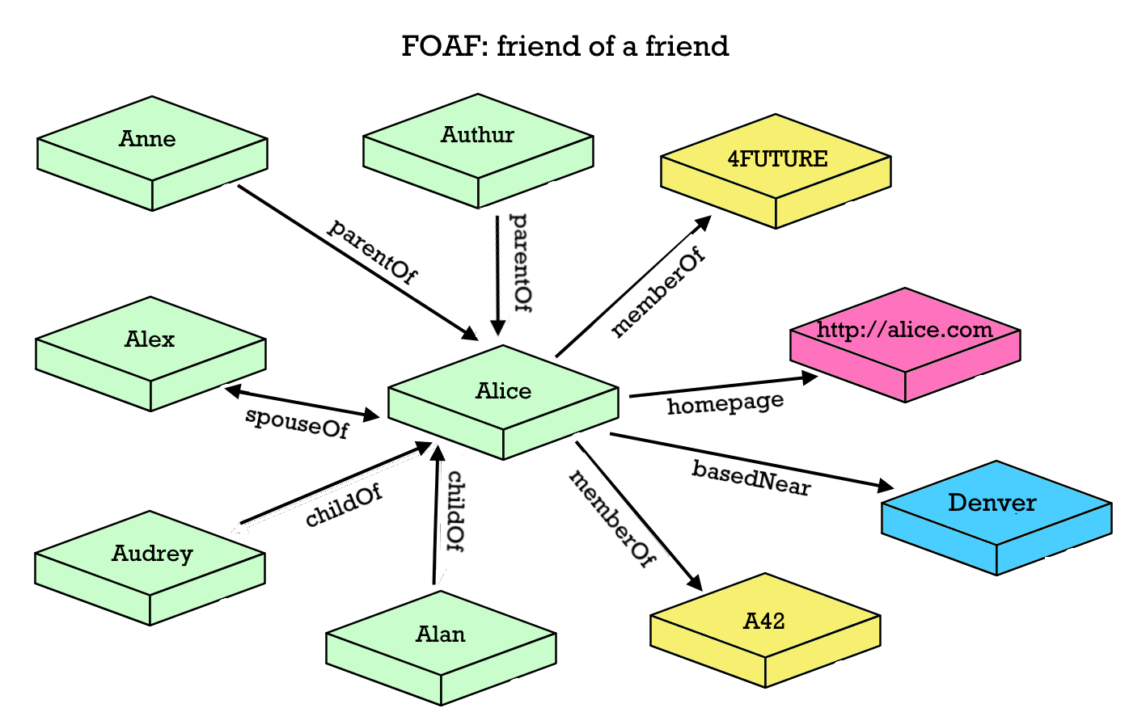
RDF – Standardizing the Triple
RDF or Resource Description Framework provides standards that we use to uniformly describe the relationships between nodes, as well as describe other attributes that we want to assign to our data as metadata.
The standard establishes a subject-predicate-object unit called a triple.
One such RDF standard, FOAF (Friend of a Friend), is a collection of relationships and attributes describing people, their relationships to one another, and their activities.
In this example, we see Alice is not just identified as a member of departments, but also as a family member based near a location, and with a descriptive home page.

Slide 13
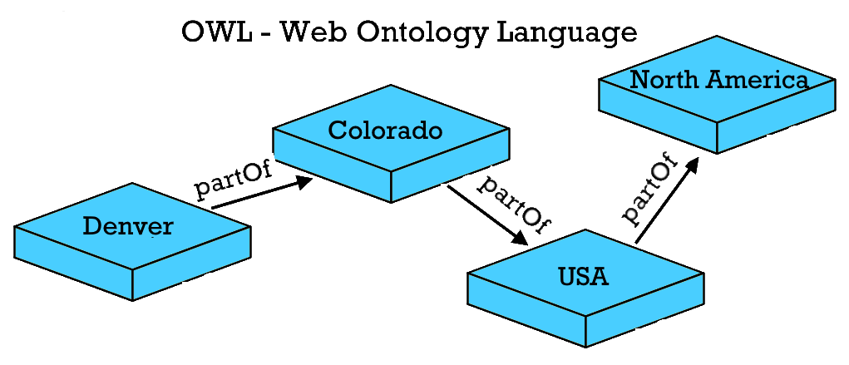
RDF – Standardizing the Triple
To extend the previous example, Denver might be linked to the state of Colorado, in the United States, in North America using RDF OWL.
Using Graph database design, and employing RDF descriptive language collections, one can create links between entities that may virtually go on and on.
What we create becomes a dynamic, three dimensional database model capable of establishing true semantic Ontologies.

Slide 14
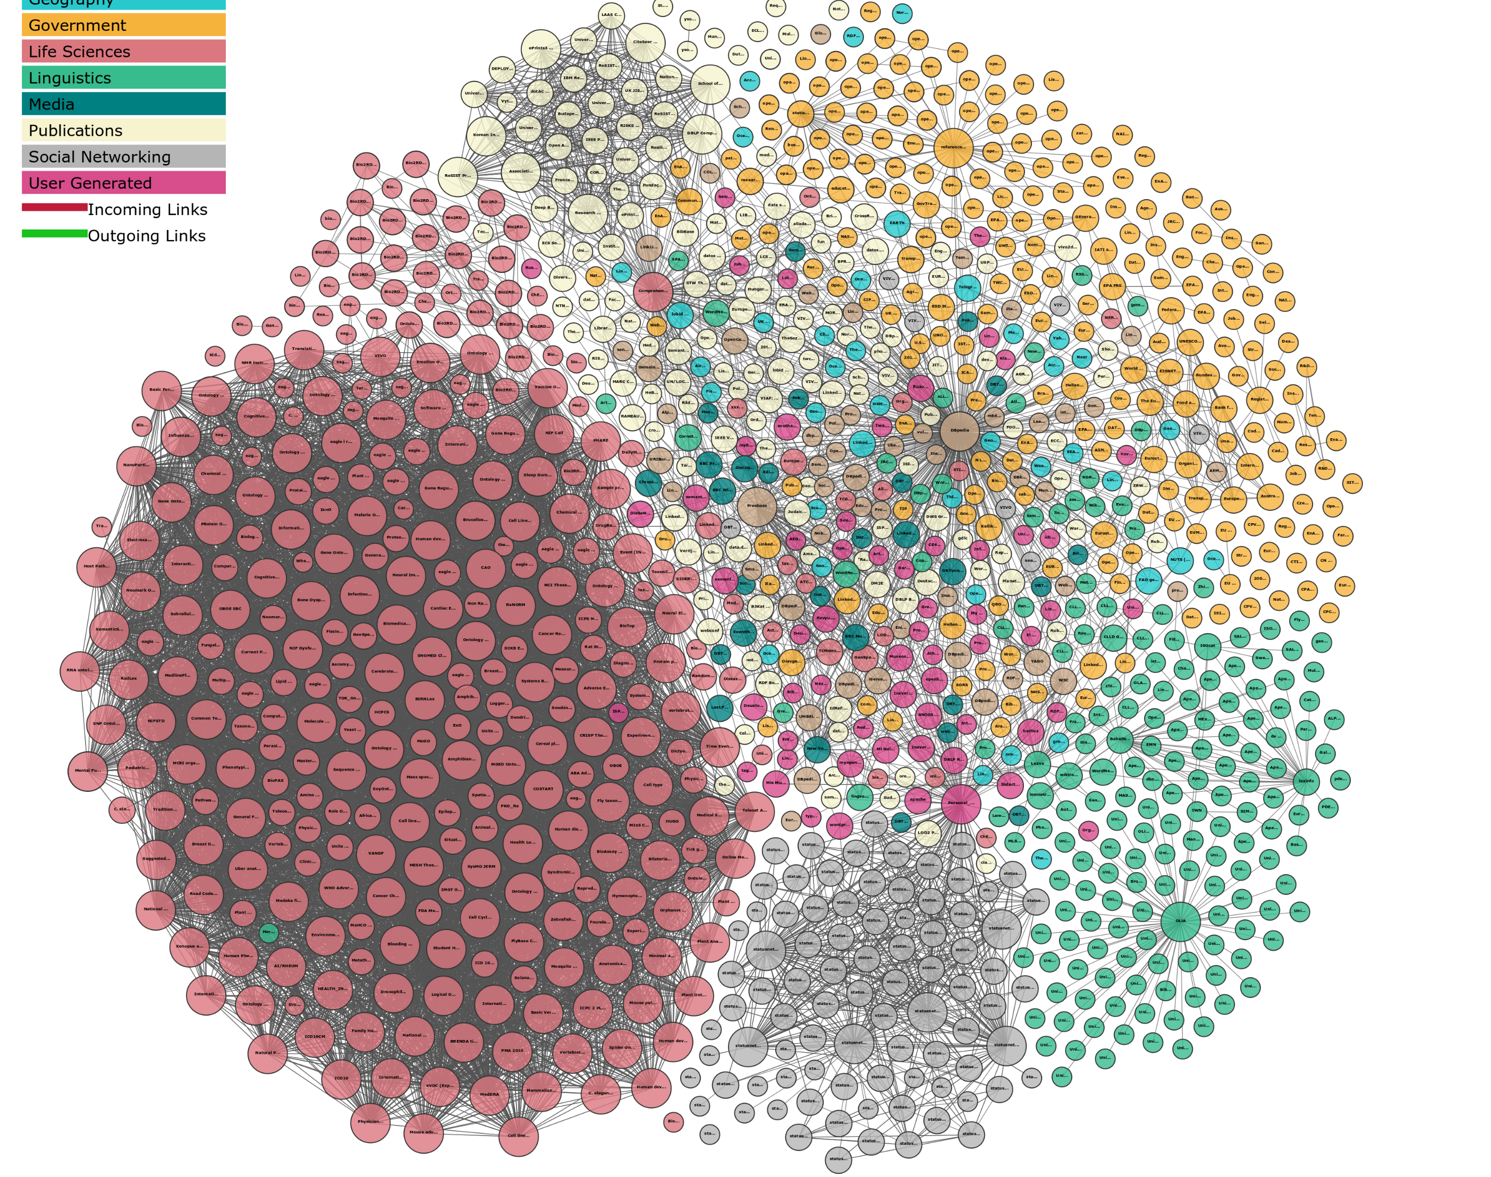
Linked Data and the Semantic Web
In 1991 Tim Berners-Lee described what he called the World Wide Web, which was meant to, “allow links to be made to any information anywhere.”¹
In the 2010’s we are seeing the concept of Linked Data realizing this goal, utilizing RDF standards and other technologies such as SPARQL (Protocol and RDF Query Language) and JSON (JavaScript Object Notation).
With Linked Data protocols, one may send queries across the web to retrieve specific information from any source published in this format.
While this is possible using RDBMS technologies as well, Graph databases speak the native language of Linked Data and start to introduce some of the most exciting potential of the World Wide Web.
Linking Open Data cloud diagram 2017, by Andrejs Abele, John P. McCrae, Paul Buitelaar,
Anja Jentzsch and Richard Cyganiak. http://lod-cloud.net/
¹ https://www.w3.org/People/Berners-Lee/1991/08/art-6484.txt

Slide 15
Pros and Cons of Graph and RDF Databases
Pros:
Graph databases are very well suited to storing information that contains many relationships and data points, leading to fast performance for pattern based searches.
SPARQL, Cypher, and other Graph query languages are generally simple and powerful.
RDF data stores can connect easily and natively to Linked Data sources.

Slide 16
Pros and Cons of Graph and RDF Databases
Cons:
Because they are not indexed as RDBMS are, they are not as effective in handing very large numbers of transactions or queries that need to capture linked information across an entire database at once.
Newer technology, less tested, not as many providers, and not as well supported, yet.
May not integrate well with legacy systems that will be consuming semantic information.

Slide 17
Conclusions
RDMBS offer a tried and true technology that is more than capable of providing the database layer for most semantic technology applications and services.
Their wide adoption in nearly all data management environments make them easy to support and integrate with external systems.
When properly indexed and designed, they are very good at handling many, simultaneous transactions.
And, they are able to handle some advanced functionality enabled by RDF and Linked Data with a little design expertise.

Slide 18
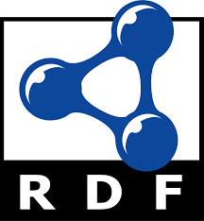
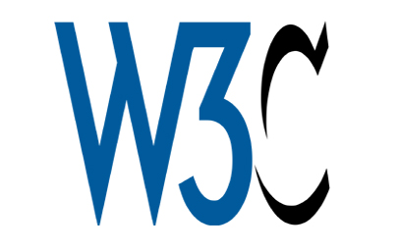
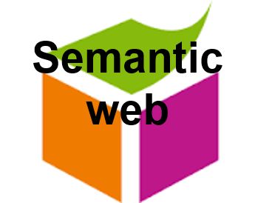
Conclusions
Graph and RDF databases are newer to the market and have yet to come close to the saturation levels that RDBMS enjoy, but they offer a design that is intrinsically effective at managing semantic information and the technologies around RDF and Linked Data.
Graph and RDF databases don’t require foreknowledge or pre-definition necessary for RDMBS design, making them able to evolve rapidly and organically.
Because Graph and RDF databases use basic, semantic structure as a key design characteristic they are very good at answering questions posed by real-life queries that we find in everyday language.

Slide 19
Resources
Explanation of Graph Structure: http://www.zdnet.com/pictures/a-graph-is-a-graph-is-graph-rdf-vs-lpg/
Data Modeling with Graph Databases: https://youtu.be/r4IGWNovzes
Designing and Building Semantic Applications with Linked Data: https://youtu.be/ToALLwM7KIw

Slide 20
Thank You!
Jim Sweeney, Senior Product Manager
jim.sweeney@synaptica.com
www.synaptica.com
Twitter: @synaptica

